Slide 1
Design Patterns
Chapter 9

Slide 2
Traversing Containers
How to visit some (or each) element
What’s the best way?

Slide 3
Example: A Linked List
CS1 Approach
Put it in the Linked List somehow
Advantages of each?
Disadvantages of each?
We will explore a third option later

Slide 4
Container Owns The Traversal
You call some first-next scheme directly from the container
Consequences:
  Can have only one traversal
    Lasts the whole lifetime of the container
  More importantly: The container is really two abstractions
    An object that holds stuff
    An object that visits what it holds (tracks “current element”)
    These can change independently

Slide 5
Single Responsibility Principle
“A class should have only one reason to change”
Therefore it should be only one abstraction
  Admittedly, if you dig deeper, it may appear to have multiple responsibilities
  It’s a perspective thing
In other words, mind the cohesion thing

Slide 6
Reification
“Reification is a term used in computer science to describe the act of making a data model for a previously abstract concept. Reification allows a computer to process an abstraction as if it were any other data.” (Wikipedia)
What did we reify in the Strategy pattern?
We will reify traversal

Slide 7
External Iteration
Encapsulate the traversal of a container in a separate abstraction
  Concrete containers return a concrete object that implements a universal iterator interface
Consequences:
  Can have multiple, concurrent iterators
    But that has its own set of problems
  So the implementation of traversal is separated from containership
    They can vary independently
    Can do different kinds of traversals
      Reverse, filter, etc.

Slide 8
The Iterator Pattern
Intent:
  Provide a way to access the elements of an aggregate object sequentially without exposing its underlying representation.
Context:
  You want to traverse a container, possibly in different ways, but you don’t want to bloat to container’s interface. You want to have a single interface for traversing distinct families of container types.
Solution:
  Create an Iterator abstraction that defines an interface for accessing the container's elements. An iterator object is responsible for keeping track of the current element; that is, it knows which elements have been traversed already.

Slide 9
4 Keys to an Iterator
An Iterator object is associated with a particular container object
  Usually when the iterator is created
It knows what the current element is
It can find the following element
It knows if there are more elements
Various Iterators may do more; this is the basic list

Slide 10
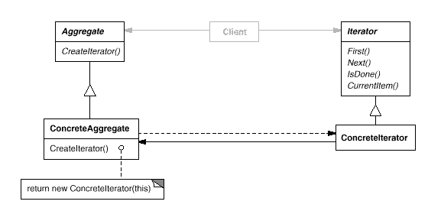
The Iterator Pattern
Class Sketch

Slide 11
Traversing via an Iterator
Iterator it = container.createIterator();
Object obj = it.First();
while (!it.isDone()) {
// Use object, then:
obj = it.Next();
}

Slide 12
Writing an Iterator
Let’s write an iterator for an array, using pictures and pseudo-code

Slide 13
Iterators in Java
Iterator interface:
  hasNext, next, remove
    Next combines First & Next & CurrentItem
SubInterface:
  ListIterator
    Bi-directional
    Mutating (set method)

Slide 14
Using Java Iterators
import java.util.*;
class Iterator1 {
public static void traverse(Collection c) {
Iterator it = c.iterator();
while (it.hasNext()) {
Object obj = it.next();
System.out.println(obj);
}
}
public static void main(String[] args) {
ArrayList stuff = new ArrayList();
stuff.add("one");
stuff.add("two");
stuff.add("three");
traverse(stuff);
}
}

Slide 15
Implementing Java Iterators
Must implement hasNext, next, and remove
  The latter can throw an exception
  It can only be called right after a next call
    Otherwise an exception must occur
    There must be something to remove!
See 3250 examples

Slide 16
Iterators in C++
An abstraction of raw pointers
  Provides *, ++, and other operators
    Forward (*, ++, ==, !=)
    Bi-directional (--)
    Random-access (+, -, +=, -=, [ ], <, <=, >, >=)
  Preserves classical pointer idioms
    *p++, etc.
The interface is therefore implicit
See 3370 example

Slide 17
Compound Iterators
For traversing compound data structures
Java example: A priority queue
Implemented as an array of linked lists
  To traverse the whole thing, need to traverse the individual lists
  But some might be empty!
    A little tricky (see PriorityQueue.iterator( ))

Slide 18
Iterators in ObjectVille
The Diner and the Pancake House have merged
The waitress needs to traverse both menus
  But they’re implemented differently
  The breakfast menu uses an Arraylist
    Can expand
  The lunch menu uses an array
What to do?
  Want to minimize changes to existing classes.
  Want to shield users from the details of the two classes
See pages 316-335, 342-344

Slide 19
Internal Iteration aka Enumeration Method
A “for-each”
You provide a function (or a Command) to (possibly conditionally) apply to each element
  You don’t access elements directly
Could be a method or a stand-alone function
Handy for structures that are hard to iterate
  Binary search trees
See InternalIter.java, InternalIter.cpp

Slide 20
Iterator Invalidation
What if the underlying data structure changes in the middle of an iteration?
  How should the current iterator respond?
Depends:
  Adding an element at the end shouldn’t hurt anything
  Deleting the current element could be okay too
  But shrinking the size of the structure below the index of the current element would not be good!
Java throws up its hands (fail fast)
C++ specifies when an iterator is invalidated

Slide 21
Another Change at the Diner
Add a dessert menu
  But it’s only available through the Dinner menu
  Not Breakfast or the Café
It’s a nested menu
How can a menu hold another menu?
  It holds menu items, not other menus
Hint: recall nested Macro Commands

Slide 22
The Composite Pattern
A generalization of a macro command
  A “recursive container” (like one big macro)
A collection can hold a concrete item (leaf) or another collection (composite)
  Nested arbitrarily deep
Results in a tree structure
  Like a directory tree
  See page 355

Slide 23
The Composite Pattern
Intent:
  Compose objects into tree structures to represent part-whole hierarchies. Lets clients treat sub-hierarchies and leaf objects uniformly
Context:
  You want to represent part-whole hierarchies (like a bill of materials or a directory tree), and want to process them through a uniform interface, ignoring their differences.
Solution:
  Derive both primitive objects and container objects from a common interface. Container objects forward requests to their children recursively until leaves are found.

Slide 24
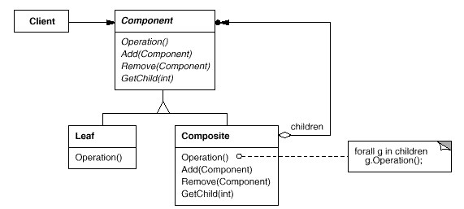
The Composite Pattern
Class Sketch

Slide 25
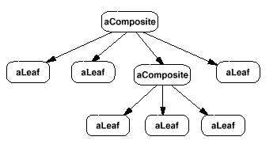
The Composite Pattern
Example Object Sketch (not UML)

Slide 26
SRP/ISP Violation?
Single Responsibility Principle
Interface Segregation Principle
The Component interface serves both containers and containees
  Child operations are no-ops for leaves
    Or they throw an exception
So be it –
  It’s the price we pay for transparent tree processing
  There is often a tension between multiple principles

Slide 27
Traversing a Composite
Internal Iteration is easy
  Recall DBCommand methods
    From Program 4
  See pages 359-364
External iteration is tricky!

Slide 28
External Iterators for Composites
Must iterate over the Component interface for transparency
Leaves don’t iterate, though!
And how do we iterate recursively into subtrees?

Slide 29
Leaves and Iterators
Leaves act as empty containers
  So just return whatever you normally do when a container is empty
    Like false for hasNext in Java
    Or the end( ) iterator value in C++
This is an example of Null Object

Slide 30
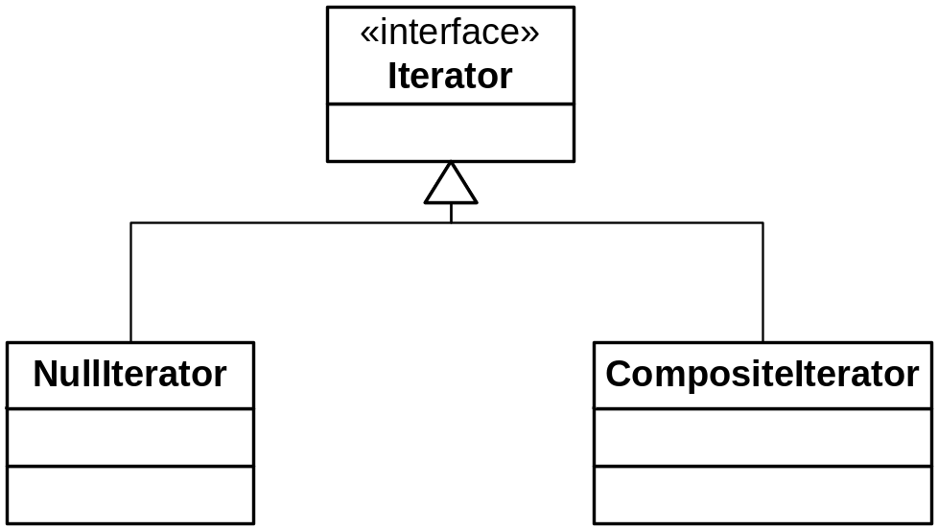
Iterator Interface for Composite

Slide 31
Recursive Iteration into Composites
Must keep track of where you are
Start with the root of the tree
  Most likely itself a composite, of course
If contained element is a leaf, return it and “advance”
If not, put the current iterator “on hold”, and start using the iterator of the contained composite
  Need a stack for LIFO handling of iterators
See CompositeTest.java
Variant: CompositeTestx.java

Slide 32
Parent Links
Allow traversing back from a component to its parent
  Nice to be able to go backwards sometimes
Issues:
  When should the parent link be set/changed?
    During Composite.add/remove
  Where should the parent attribute reside?
    In Component
See CompositeTest2.java

Slide 33
OCP Redux
The Open/Closed Principle
  Add functionality without changing code
We did this before with Decorator
  A wrapper which programmed to the interface
But now we have to distinguish between leaves and composites
How can we add functionality to a closed hierarchy?
  Such that behavior can vary across concrete types

Slide 34
Visitors
If a hierarchy can accept “visitors”, we can do pretty much anything
An “accept” method in the hierarchy welcomes visitors polymorphically
The accept method calls the visitors operation (also polymorphically!)
  This is called “double dispatch)

Slide 35
The Visitor Pattern
Intent:
  Define an operation to be performed on objects in a hierarchy without changing the classes in the hierarchy
Context:
  You need to add one or more methods to a hierarchy, but you would rather not disturb the hierarchy itself (the interface is pretty complete as is). In particular, the operation of the new method needs to be polymorphic across the subject hierarchy.
Solution:
  Define an accept method in the object hierarchy that accepts a visitor. Define concrete visitors that know how to handle each concrete element type to provide a desired operation.

Slide 36
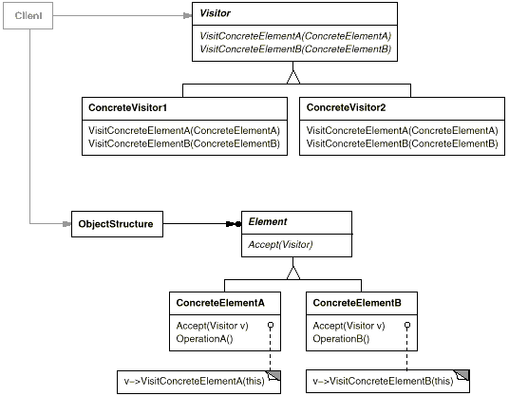
The Visitor Pattern
Class Sketch

Slide 37
The Visitor Pattern
Comments
Note that Visitor has a method for each concrete target type
  So accept is called polymorphically
The accept method calls visitor.visit(this)
  i.e., it passes a pointer to itself (the concrete object)
  So the visit method is called polymorphically too
  So the right combination of subject and visitor is invoked

Slide 38
The Visitor Pattern
Examples
VisitorTest.java
VisitorDemo.java
CompositeTest3.java
  Visits a composite using an external iterator
  As always, it’s easier to use an internal iterator
    The accept method is the internal iterator!

Slide 39
Double Dispatch
How Visitor works
Different than operator overloading
  Which is resolved at compile time
Multiple dispatch is resolved through runtime polymorphism

Slide 40
Report Generators
A typical application of Visitor
Suppose you have a Bill of Materials composite
  Parts made of other parts, etc.
  You want a readable, indented invoice
You can have different visitors generate different reports
  See next slide

Slide 41
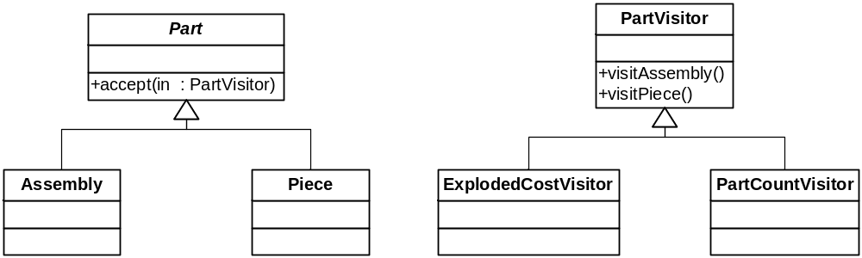
Report Visitors

Slide 42
Visitor Controversy
Not everyone likes it!
  Erich Gamma is reported to have said he regrets putting Visitor in.

Slide 43
Visitor Minuses
Knowledge of the visited hierarchy needed
Extending the Visitor hierarchy often requires expert knowledge of the hierarchy’s design

Slide 44
Visitor Plusses
Addition of behavior to a closed hierarchy
  If an accept() method is provided
Common application: language parsing
  Visitor can visit abstract syntax trees
  Note that in this case, and most cases where visitors work well:
    The visited hierarchy has little behavior – it is all in the Visitor hierarchy.

